Slide 1
Classical Waterfall Model
The classical waterfall model is the basic software development life cycle model. It is very simple but idealistic. Earlier this model was very popular but nowadays it is not used. But it is very important because all the other software development life cycle models are based on the classical waterfall model. The classical waterfall model divides the life cycle into a set of phases. This model considers that one phase can be started after the completion of the previous phase. That is the output of one phase will be the input to the next phase. Thus the development process can be considered as a sequential flow in the waterfall. Here the phases do not overlap with each other.

Slide 2
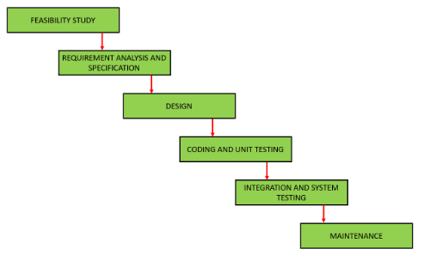
Classical Waterfall Model
The different sequential phases of the classical waterfall model are shown in the below figure:

Slide 3
Classical Waterfall Model
1. Feasibility Study: The main goal of this phase is to determine whether it would be financially and technically feasible to develop the software. The feasibility study involves understanding the problem and then determining the various possible strategies to solve the problem. These different identified solutions are analyzed based on their benefits and drawbacks, The best solution is chosen and all the other phases are carried out as per this solution strategy.

Slide 4
Classical Waterfall Model
2. Requirements analysis and specification: The aim of the requirement analysis and specification phase is to understand the exact requirements of the customer and document them properly. This phase consists of two different activities.
Requirement gathering and analysis: Firstly all the requirements regarding the software are gathered from the customer and then the gathered requirements are analyzed. The goal of the analysis part is to remove incompleteness (an incomplete requirement is one in which some parts of the actual requirements have been omitted) and inconsistencies (an inconsistent requirement is one in which some part of the requirement contradicts some other part).
Requirement specification: These analyzed requirements are documented in a software requirement specification (SRS) document. SRS document serves as a contract between the development team and customers. Any future dispute between the customers and the developers can be settled by examining the SRS document.

Slide 5
Classical Waterfall Model
3. Design: The goal of this phase is to convert the requirements acquired in the SRS into a format that can be coded in a programming language. It includes high-level and detailed design as well as the overall software architecture. A Software Design Document is used to document all of this effort (SDD)
4. Coding and Unit testing: In the coding phase software design is translated into source code using any suitable programming language. Thus each designed module is coded. The aim of the unit testing phase is to check whether each module is working properly or not.

Slide 6
Classical Waterfall Model
5. Integration and System testing: Integration of different modules are undertaken soon after they have been coded and unit tested. Integration of various modules is carried out incrementally over a number of steps. During each integration step, previously planned modules are added to the partially integrated system and the resultant system is tested. Finally, after all the modules have been successfully integrated and tested, the full working system is obtained and system testing is carried out on this.
6. Maintenance: Maintenance is the most important phase of a software life cycle. The effort spent on maintenance is 60% of the total effort spent to develop a full software.

Slide 7
Classical Waterfall Model
Advantages of Classical Waterfall Model:-
This model is very simple and is easy to understand.
Phases in this model are processed one at a time.
Each stage in the model is clearly defined.
This model has very clear and well-understood milestones.
Process, actions and results are very well documented.
Reinforces good habits: define-before- design, design-before-code.
This model works well for smaller projects and projects where requirements are well understood.

Slide 8
Classical Waterfall Model
Drawbacks of Classical Waterfall Model:-
No feedback path: In the classical waterfall model evolution of software from one phase to another phase is like a waterfall. It assumes that no error is ever committed by developers during any phase. Therefore, it does not incorporate any mechanism for error correction.
Difficult to accommodate change requests: This model assumes that all the customer requirements can be completely and correctly defined at the beginning of the project, but actually customers’ requirements keep on changing with time. It is difficult to accommodate any change requests after the requirements specification phase is complete.
No overlapping of phases: This model recommends that a new phase can start only after the completion of the previous phase. But in real projects, this can’t be maintained. To increase efficiency and reduce cost, phases may overlap.

